Slide 1
Showcase Your Teaching: Beyond Student Evaluations
Annette Caldwell Simmons School of Education and Human Development
Department of Teaching & Learning
Department of Education Policy & Leadership
NFTE April 2013
Gail Hartin & Paige Ware

Slide 2
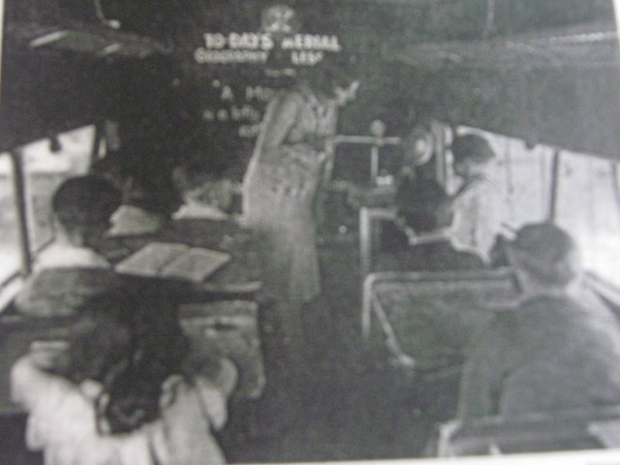
Cuban, L. (1993). How teachers taught: Constancy and change in American classrooms. New York: Teachers College Press.

Slide 3
What works in your teaching context?
BS (Borrow Straight)
BA (Borrow and Adapt)
BB (Back Burner)

Slide 4
Average = 3.5

Slide 5

http://images.google.com/search?hl=en&site=&tbm=isch&source=hp&biw=1234&bih=656&q=help&oq=help&gs_l=img.3..0l10.1044.1971.0.2253.4.4.0.0.0.0.133.342.3j1.4.0...0.0...1ac.1.7.img.pIrcLTriZTE#imgrc=rU0KA1WoVX2mmM%3A%3BBJCe0cFPK5hxlM%3Bhttp%253A%252F%252Fwww.stuartduncan.name%252Fwp-content%252Fuploads%252F2011%252F05%252FWiley-Coyote-Help.jpg%3Bhttp%253A%252F%252Fwww.stuartduncan.name%252Fautism%252Fhow-mario-taught-me-just-how-much-help-to-give-to-my-children%252F%3B309%3B425

Slide 6
Teaching &
Conversing
Teaching Portfolio
1. Critical friends group
2. Brownbag lunches
3. Committee work
4. Pilot program

Slide 7
Portfolio: 3 examples
Relationships
Course syllabi or assignments that demonstrate your growth or teaching innovations you have implemented and revised over time with explanation of changes with rationale.
Statements from colleagues who have taught with you, reviewed your teaching and learning materials, sought out your advice on a range of teaching issues, and/or consulted with you on advising or mentoring issues.
Formal student feedback, such as results of mid-semester feedback.
Formative assessment solicited from students and ways you changed instruction based on that feedback.
Statement of teaching philosophy with specific examples of how that philosophy can be seen in your classes/other interactions with students.
Invitations to speak to professional colleagues about teaching and learning practices (on campus, locally, regionally, or nationally) or leadership practices.
Evidence of participation in faculty development activities related to teaching/ teaching in your discipline on campus, regionally, or nationally and how you used what you learned.
Letters of support from alumni or former students about the quality of your instruction.
Evidence of impact on their professional careers (e.g., helping them to secure employment or admission to graduate school).
Evidence of your students’ success, particularly for faculty who do a lot of advising (graduate or undergraduate).
Student publications or evidence of co-authorship.
Evidence of effective academic supervision of Honors, Master’s, or Ph.D.
Samples of student work (e.g., essays, creative work, project or field-work reports, lab reports, etc.) and how you responded to that particular work sample.
Informal student feedback you may have received, e.g., thank you letters, emails of appreciation, etc.
Course development, assessment development, or course activity development.
Other evidence, proposed by faculty member, approved by chair.
Book study.
Study groups formed through curriculum committees.
Participation in Critical Friends’ groups
Investigation/presentation on developing stronger interpersonal relationships with students and on fostering student engagement and accountability.
Investigation/presentation on building bridges between what the teacher knows and what the student is trying to grasp.
Investigation/presentation on different teaching strategies, especially related to technology.
Investigation/presentation on feedback mechanism to learn about tangible changes in courses, teaching strategies and methodologies, or curricula resulting from the program.
Growth
Initiative

Slide 8
Formative assessment solicited from students and ways you changed instruction based on that feedback.
Informal student feedback: Student growth as a result of acting on student feedback
“Needs and gots” cards: Instructor growth
Growth

Slide 9
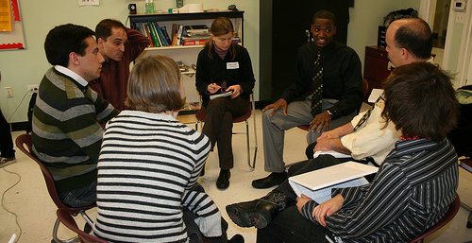
http://farm3.static.flickr.com/2209/2221288333_7c637c1d9d.jpg?v=0

Slide 11
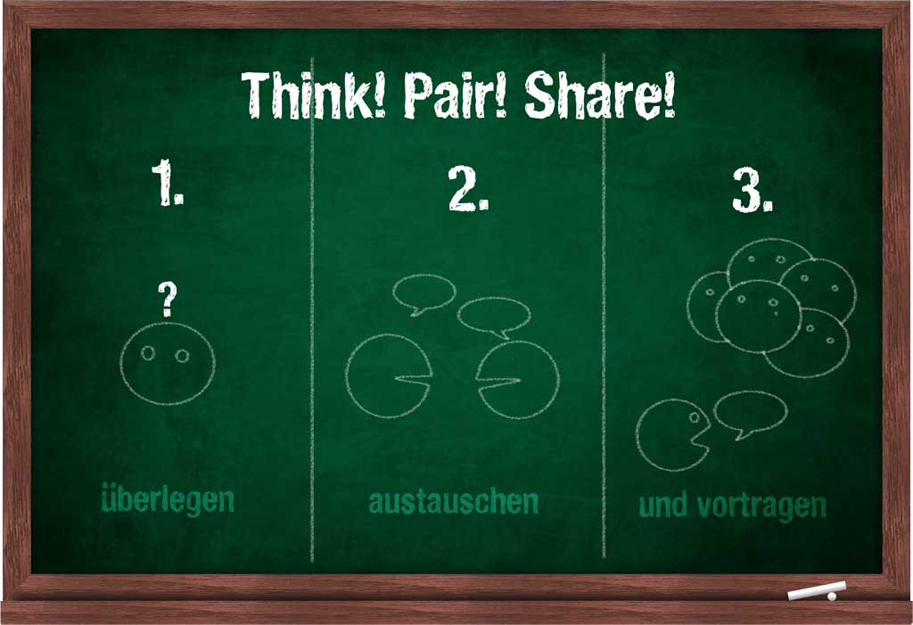
http://images.google.com/search?hl=en&site=&tbm=isch&source=hp&biw=1234&bih=656&q=think+pair+share&oq=think+pair+share&gs_l=img.3..0l5j0i24l5.1253.3240.0.3381.18.13.1.4.4.0.98.1039.13.13.0...0.0...1ac.1.7.img.emzWa0Z9Tbw#imgrc=4N-y8klEGFwCNM%3A%3B42zLs_PuwMwa_M%3Bhttp%253A%252F%252Fschuelerecke.net%252Fschule%252Fwp-content%252Fuploads%252F2010%252F06%252FThinkPairShare.jpg%3Bhttp%253A%252F%252Fschuelerecke.net%252Fschule%252Fthink-pair-share-%2525E2%252580%252593-unterrichtsprinzip-mit-kleinem-aufwand-und-grosem-effekt%252F%3B1024%3B701
How can YOU use formative assessment to showcase your growth?

Slide 12
Course development, assessment development, or course activity development.
Technology integration
Developing rubrics as part of course development for a new degree program
Initiative

Slide 15

Final Project Rubric EDU 6241 Organizational Behavior
 | Below expectations value: 1 | Evolving value: 2-3 | Distinguished value: 4 | Score/ Level
Initiative/Goal | Initiative is not related to any of the school's stated goals. | Initiative selected is not relevant to the role of a leader or does not support positive student outcomes. | Initiative selected is relevant to the role of a leader and supports positive student outcomes.
Data | There is no discussion of data or needs assessment | Data collected are somewhat related to the need for the goal and the steps of the action plan. | Data collected are clearly related to the need for the goal and the steps of the action plan.
Analysis-role of factors related to organizational behavior | Multiple areas of relevant organizational theory are omitted. | One major aspect of relevant organizational theory is missing. | All identified aspects of organizational theory are addressed.
Checkpoints | Checkpoint 4 not met, and one or more interim checkpoints not met. | Checkpoint 4 not met; interim checkpoints met (based on feedback from FS instructor). | All checkpoints met, including the final product.
Professionally presented | Multiple Errors | Formatting instructions not followed, OR no more than 2 errors. | Formatted as requested; no errors in usage, spelling, syntax, etc.
Competencies 001 and 002 addressed: Competency 001: (development, articulation, implementation, and stewardship of a vision of learning) Competency 002: (communication and collaborate with all members of the school community) | No relationship between the reflection section of the project and the competencies addressed. | Vague relationship between the reflection section of the project and the competencies addressed. | Strong understanding of the connections between the project and the competencies addressed.

Slide 16
http://images.google.com/search?hl=en&site=&tbm=isch&source=hp&biw=1234&bih=656&q=think+pair+share&oq=think+pair+share&gs_l=img.3..0l5j0i24l5.1253.3240.0.3381.18.13.1.4.4.0.98.1039.13.13.0...0.0...1ac.1.7.img.emzWa0Z9Tbw#imgrc=4N-y8klEGFwCNM%3A%3B42zLs_PuwMwa_M%3Bhttp%253A%252F%252Fschuelerecke.net%252Fschule%252Fwp-content%252Fuploads%252F2010%252F06%252FThinkPairShare.jpg%3Bhttp%253A%252F%252Fschuelerecke.net%252Fschule%252Fthink-pair-share-%2525E2%252580%252593-unterrichtsprinzip-mit-kleinem-aufwand-und-grosem-effekt%252F%3B1024%3B701
How can you showcase your initiative in course development?

Slide 17
Statements from colleagues who have taught with you, reviewed your teaching and learning materials, sought out your advice on a range of teaching issues, and/or consulted with you on advising or mentoring issues.
Relationships with colleagues: Peer feedback/coaching
Relationships with students: Unsolicited kudos
Relationships

Slide 18
Evaluator
Person
Expert
Facilitator

Slide 20
You have been like a hard-working bee, flying here and there. Thank you so much for your feedback and the opportunity. I will surely use it.
I'm so glad to have you as my teacher that helps me grow to the maximum. Thanks Again!!!
Every time I see you, talk to you, somehow it makes me feel that writing is not that difficult and I can do it.
I can never tell you how much I appreciate you! You might not realize but you have helped bring back my self-efficacy.
Anyway, I notice that you have tried to use positive enforcement as much as possible in my draft, which is always very encouraging. Furthermore, you have also provided constructive feedback to address my weaknesses. I have always been amazed at how you help "fix" my paper. This is my wonder.
Dr. Ware must be a professional "sewer" and tailor! She is so skillful at sewing my "broken" pieces of writing together and making customized suggestions to address every weakness.

Slide 21
http://images.google.com/search?hl=en&site=&tbm=isch&source=hp&biw=1234&bih=656&q=think+pair+share&oq=think+pair+share&gs_l=img.3..0l5j0i24l5.1253.3240.0.3381.18.13.1.4.4.0.98.1039.13.13.0...0.0...1ac.1.7.img.emzWa0Z9Tbw#imgrc=4N-y8klEGFwCNM%3A%3B42zLs_PuwMwa_M%3Bhttp%253A%252F%252Fschuelerecke.net%252Fschule%252Fwp-content%252Fuploads%252F2010%252F06%252FThinkPairShare.jpg%3Bhttp%253A%252F%252Fschuelerecke.net%252Fschule%252Fthink-pair-share-%2525E2%252580%252593-unterrichtsprinzip-mit-kleinem-aufwand-und-grosem-effekt%252F%3B1024%3B701
How can YOU showcase your relationships?

Slide 22
What works in your teaching context?
BS (Borrow Straight)
BA (Borrow and Adapt)
BB (Back Burner)

Slide 23
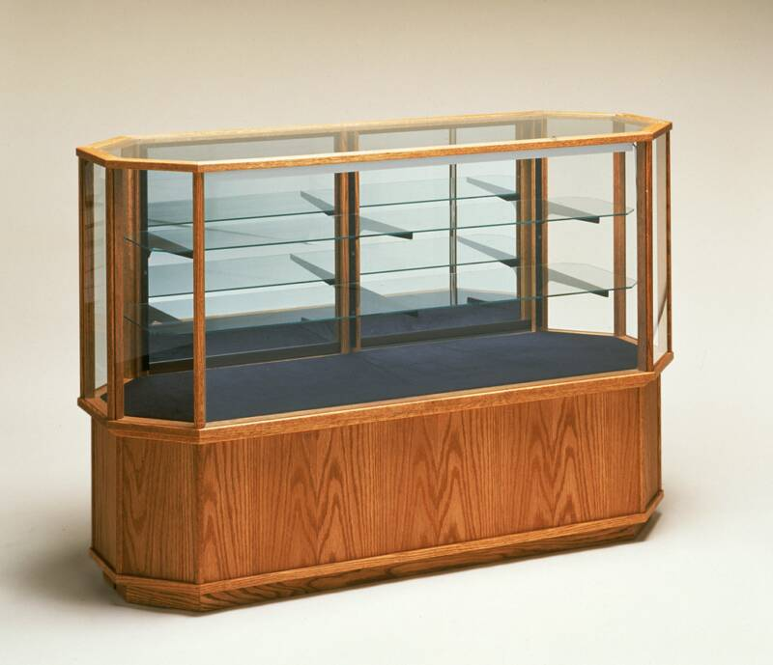
Shttp://images.google.com/search?hl=en&site=&tbm=isch&source=hp&biw=1234&bih=656&q=bs+ba&oq=bs+ba&gs_l=img.3..0j0i24l9.731.3374.0.3756.9.7.2.0.0.0.174.628.5j2.7.0...0.0...1ac.1.7.img.wmKotWRZMnk#hl=en&tbm=isch&sa=1&q=showcase&oq=showcase&gs_l=img.3..0l10.25249.28297.6.28412.21.17.0.3.3.4.140.1384.11j5.16.0...0.0...1c.1.7.img.ZsMrwamcLv8&bav=on.2,or.r_cp.r_qf.&bvm=bv.44342787,d.aWM&fp=995854d35c27c64b&biw=1234&bih=656&imgrc=C8Ms3Yj6pjwI2M%3A%3BIwpFH_I8UxrGMM%3Bhttp%253A%252F%252Fwww.showcases-smart.com%252Fwp-content%252Fuploads%252F2010%252F05%252F60in-wide-full-vision-octagon-showcase-display-case-hof6848.jpg%3Bhttp%253A%252F%252Fwww.showcases-smart.com%252Fhorizontal-showcases%252F%3B800%3B689
Open Discussion
How do you present each item visually?
How do you connect each item conceptually?
Who is your audience?

